Slide 1
雲端計算
Cloud Computing
PaaS Techniques
File System

Slide 2
Agenda
Overview
  Hadoop & Google
PaaS Techniques
  File System
    GFS, HDFS
  Programming Model
    MapReduce, Pregel
  Storage System for Structured Data
    Bigtable, Hbase

Slide 3

Hadoop
Hadoop is
  A distributed computing platform
  A software framework that lets one easily write and run applications that process vast amounts of data
  Inspired from published papers by Google
Cloud Applications
MapReduce
Hbase
Hadoop Distributed
File System (HDFS)
A Cluster of Machines

Slide 4

Google
Google published the designs of web-search engine
  SOSP 2003
    The Google File System
  OSDI 2004
    MapReduce : Simplified Data Processing on Large Cluster
  OSDI 2006
    Bigtable: A Distributed Storage System for Structured Data

Slide 5
Google vs. Hadoop
Develop Group | Google | Apache
Sponsor | Google | Yahoo, Amazon
Resource | open document | open source
File System | GFS | HDFS
Programming Model | MapReduce | Hadoop MapReduce
Storage System (for structure data) | Bigtable | Hbase
Search Engine | Google | Nutch
OS | Linux | Linux / GPL

Slide 6
Agenda
Overview
  Hadoop & Google
PaaS Techniques
  File System
    GFS, HDFS
  Programming Model
    MapReduce, Pregel
  Storage System for Structured Data
    Bigtable, Hbase

Slide 7
File System
File System Overview
Distributed File Systems (DFS)
Google File System (GFS)
Hadoop Distributed File Systems (HDFS)

Slide 8
File System Overview
System that permanently stores data
To store data in units called “files” on disks and other media
Files are managed by the Operating System
The part of the Operating System that deal with files is known as the “File System”
  A file is a collection of disk blocks
  File System maps file names and offsets to disk blocks
The set of valid paths form the “namespace” of the file system.

Slide 9
What Gets Stored
User data itself is the bulk of the file system's contents
Also includes meta-data on a volume-wide and per-file basis:
Volume-wide
Per-file
Available space
Formatting info.
Character set
…
Name
Owner
Modification data
…

Slide 10
Design Considerations
Namespace
  Physical mapping
  Logical volume
Consistency
  What to do when more than one user reads/writes on the same file?
Security
  Who can do what to a file?
  Authentication/Access Control List (ACL)
Reliability
  Can files not be damaged at power outage or other hardware failures?

Slide 11
Local FS on Unix-like Systems(1/4)
Namespace
  root directory “/”, followed by directories and files.
Consistency
  “sequential consistency”, newly written data are immediately visible to open reads
Security
  uid/gid, mode of files
  kerberos: tickets
Reliability
  journaling, snapshot

Slide 12
Local FS on Unix-like Systems(2/4)
Namespace
  Physical mapping
    a directory and all of its subdirectories are stored on the same physical media
      /mnt/cdrom
      /mnt/disk1, /mnt/disk2, … when you have multiple disks
  Logical volume
    a logical namespace that can contain multiple physical media or a partition of a physical media
      still mounted like /mnt/vol1
      dynamical resizing by adding/removing disks without reboot
      splitting/merging volumes as long as no data spans the split

Slide 13
Local FS on Unix-like Systems(3/4)
Journaling
  Changes to the filesystem is logged in a journal before it is committed
    useful if an atomic action needs two or more writes
      e.g., appending to a file (update metadata + allocate space + write the data)
    can play back a journal to recover data quickly in case of hardware failure.
  What to log?
    changes to file content: heavy overhead
    changes to metadata: fast, but data corruption may occur
  Implementations: xfs3, ReiserFS, IBM's JFS, etc.

Slide 14
Local FS on Unix-like Systems(4/4)
Snapshot
  A snapshot = a copy of a set of files and directories at a point in time
    read-only snapshots, read-write snapshots
    usually done by the filesystem itself, sometimes by LVMs
    backing up data can be done on a read-only snapshot without worrying about consistency
  Copy-on-write is a simple and fast way to create snapshots
    current data is the snapshot
    a request to write to a file creates a new copy, and work from there afterwards
  Implementation: UFS, Sun's ZFS, etc.

Slide 15
File System
File System Overview
Distributed File Systems (DFS)
Google File System (GFS)
Hadoop Distributed File Systems (HDFS)

Slide 16
Distributed File Systems
Allows access to files from multiple hosts sharing via a computer network
Must support concurrency
  Make varying guarantees about locking, who “wins” with concurrent writes, etc...
  Must gracefully handle dropped connections
May include facilities for transparent replication and fault tolerance
Different implementations sit in different places on complexity/feature scale

Slide 17
When is DFS Useful
Multiple users want to share files
The data may be much larger than the storage space of a computer
A user want to access his/her data from different machines at different geographic locations
Users want a storage system
  Backup
  Management
Note that a “user” of a DFS may actually be a “program”

Slide 18
Design Considerations of DFS(1/2)
Different systems have different designs and behaviors on the following features
  Interface
    file system, block I/O, custom made
  Security
    various authentication/authorization schemes
  Reliability (fault-tolerance)
    continue to function when some hardware fail (disks, nodes, power, etc.)

Slide 19
Design Considerations of DFS(2/2)
  Namespace (virtualization)
    provide logical namespace that can span across physical boundaries
  Consistency
    all clients get the same data all the time
    related to locking, caching, and synchronization
  Parallel
    multiple clients can have access to multiple disks at the same time
  Scope
    local area network vs. wide area network

Slide 20
File System
File System Overview
Distributed File Systems (DFS)
Google File System (GFS)
Hadoop Distributed File Systems (HDFS)

Slide 21
Google File System
How to process large data sets and easily
utilize the resources of a large distributed system …

Slide 22
Google File System
Motivations
Design Overview
System Interactions
Master Operations
Fault Tolerance

Slide 23
Motivations
Fault-tolerance and auto-recovery need to be built into the system.
Standard I/O assumptions (e.g. block size) have to be re-examined.
Record appends are the prevalent form of writing.
Google applications and GFS should be co-designed.

Slide 24
Design Overview
Assumptions
Architecture
Metadata
Consistency Model

Slide 25
Assumptions(1/2)
High component failure rates
  Inexpensive commodity components fail all the time
  Must monitor itself and detect, tolerate, and recover from failures on a routine basis
Modest number of large files
  Expect a few million files, each 100 MB or larger
  Multi-GB files are the common case and should be managed efficiently
The workloads primarily consist of two kinds of reads
  large streaming reads
  small random reads

Slide 26
Assumptions(2/2)
The workloads also have many large, sequential writes that append data to files
  Typical operation sizes are similar to those for reads
Well-defined semantics for multiple clients that concurrently append to the same file
High sustained bandwidth is more important than low latency
  Place a premium on processing data in bulk at a high rate, while have stringent response time

Slide 27
Design Decisions
Reliability through replication
Single master to coordinate access, keep metadata
  Simple centralized management
No data caching
  Little benefit on client: large data sets / streaming reads
  No need on chunkserver: rely on existing file buffers
  Simplifies the system by eliminating cache coherence issues
Familiar interface, but customize the API
  No POSIX: simplify the problem; focus on Google apps
  Add snapshot and record append operations

Slide 28
Design Overview
Assumptions
Architecture
Metadata
Consistency Model

Slide 29
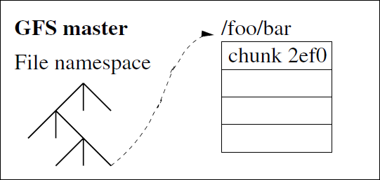
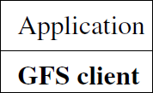
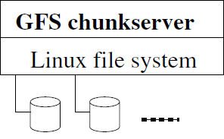
Architecture
Identified by
an immutable
and globally
unique 64 bit
chunk handle

Slide 30
Roles in GFS
Roles: master, chunkserver, client
  Commodity Linux box, user level server processes
  Client and chunkserver can run on the same box
Master holds metadata
Chunkservers hold data
Client produces/consumes data

Slide 31
Single Master
The master have global knowledge of chunks
  Easy to make decisions on placement and replication
From distributed systems we know this is a:
  Single point of failure
  Scalability bottleneck
GFS solutions:
  Shadow masters
  Minimize master involvement
    never move data through it, use only for metadata
    cache metadata at clients
    large chunk size
    master delegates authority to primary replicas in data mutations(chunk leases)

Slide 32
Chunkserver - Data
Data organized in files and directories
  Manipulation through file handles
Files stored in chunks (c.f. “blocks” in disk file systems)
  A chunk is a Linux file on local disk of a chunkserver
  Unique 64 bit chunk handles, assigned by master at creation time
  Fixed chunk size of 64MB
  Read/write by (chunk handle, byte range)
  Each chunk is replicated across 3+ chunkservers

Slide 33
Chunk Size
Each chunk size is 64 MB
A large chunk size offers important advantages when stream reading/writing
  Less communication between client and master
  Less memory space needed for metadata in master
  Less network overhead between client and chunkserver (one TCP connection for larger amount of data)
On the other hand, a large chunk size has its disadvantages
  Hot spots
  Fragmentation

Slide 34
Design Overview
Assumptions
Architecture
Metadata
Consistency Model

Slide 35
Metadata
GFS master
• Namespace(file, chunk)
• Mapping from files to chunks
• Current locations of chunks
• Access Control Information
All in memory during operation

Slide 36
Metadata (cont.)
Namespace and file-to-chunk mapping are kept persistent
  operation logs + checkpoints
Operation logs = historical record of mutations
  represents the timeline of changes to metadata in concurrent operations
  stored on master's local disk
  replicated remotely
A mutation is not done or visible until the operation log is stored locally and remotely
  master may group operation logs for batch flush

Slide 37
Recovery
Recover the file system = replay the operation logs
  “fsck” of GFS after, e.g., a master crash.
Use checkpoints to speed up
  memory-mappable, no parsing
  Recovery = read in the latest checkpoint + replay logs taken after the checkpoint
  Incomplete checkpoints are ignored
  Old checkpoints and operation logs can be deleted.
Creating a checkpoint: must not delay new mutations
  Switch to a new log file for new operation logs: all operation logs up to now are now “frozen”
  Build the checkpoint in a separate thread
  Write locally and remotely

Slide 38
Chunk Locations
Chunk locations are not stored in master's disks
  The master asks chunkservers what they have during master startup or when a new chunkserver joins the cluster
  It decides chunk placements thereafter
  It monitors chunkservers with regular heartbeat messages
Rationale
  Disks fail
  Chunkservers die, (re)appear, get renamed, etc.
  Eliminate synchronization problem between the master and all chunkservers

Slide 39
Design Overview
Assumptions
Architecture
Metadata
Consistency Model

Slide 40
Consistency Model
GFS has a relaxed consistency model
File namespace mutations are atomic and consistent
  handled exclusively by the master
  namespace lock guarantees atomicity and correctness
  order defined by the operation logs
File region mutations: complicated by replicas
  “Consistent” = all replicas have the same data
  “Defined” = consistent + replica reflects the mutation entirely
  A relaxed consistency model: not always consistent, not always defined, either

Slide 41
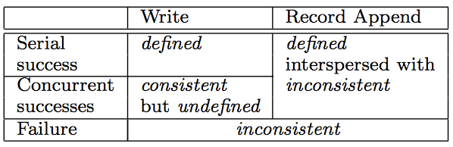
Consistency Model (cont.)

Slide 42
Google File System
Motivations
Design Overview
System Interactions
Master Operations
Fault Tolerance

Slide 43
System Interactions
Read/Write
Concurrent Write
Atomic Record Appends
Snapshot

Slide 44
While reading a file
Application
GFS Client
Master
Chunkserver
Open(name, read)
name
Open
handle
handle
Read(handle, offset,
length, buffer)
handle,
chunk_index
cache (handle,
chunk_index)
→
(chunk_handle,
locations),
select a replica
chunk_handle,
chunk_locations
Read
chunk_handle,
byte_range
Data
return code

Slide 45
While writing to a File
Application
GFS Client
Master
Chunkserver
Primary Chunkserver
Chunkserver
Chunkserver
Write(handle,
offset,length,
buffer)
handle
grants a lease
(if not granted before)
Query
chunk_handle,
primary_id, Rep- lica_locations
cache, select a replica
Data
Data
Data
Data Push
data received
received
write (ids)
m. order(*)
m. order(*)
Commit
complete
complete
completed
return code
* assign mutation
order, write to disk

Slide 46
Lease Management
A crucial part of concurrent write/append operation
  Designed to minimize master's management overhead by authorizing chunkservers to make decisions
One lease per chunk
  Granted to a chunkserver, which becomes the primary
  Granting a lease increases the version number of the chunk
  Reminder: the primary decides the mutation order
The primary can renew the lease before it expires
  Piggybacked on the regular heartbeat message
The master can revoke a lease (e.g., for snapshot)
The master can grant the lease to another replica if the current lease expires (primary crashed, etc)

Slide 47
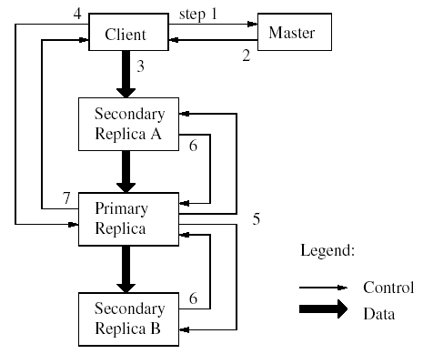
Mutation
Client asks master for replica locations
Master responds
Client pushes data to all replicas; replicas store it in a buffer cache
Client sends a write request to the primary (identifying the data that had been pushed)
Primary forwards request to the secondaries (identifies the order)
The secondaries respond to the primary
The primary responds to the client

Slide 48
Mutation (cont.)
Mutation = write or append
  must be done for all replicas
Goal
  minimize master involvement
Lease mechanism for consistency
  master picks one replica as primary; gives it a “lease” for mutations
  a lease = a lock that has an expiration time
  primary defines a serial order of mutations
  all replicas follow this order
Data flow is decoupled from control flow

Slide 49
System Interactions
Read/Write
Concurrent Write
Atomic Record Appends
Snapshot

Slide 50
Concurrent Write
If two clients concurrently write to the same region of a file, any of the following may happen to the overlapping portion:
  Eventually the overlapping region may contain data from exactly one of the two writes.
  Eventually the overlapping region may contain a mixture of data from the two writes.
Furthermore, if a read is executed concurrently with a write, the read operation may see either all of the write, none of the write, or just a portion of the write.

Slide 51
Consistency Model (remind)

Slide 52
Write/Concurrent Write
Region inconsistent
Region consistent
Region consistent but undefined
Write X at region @ in C1
Write xyz at region @ in C1
xyzabc
xyzabc
xyzabc
X
X
X
Write abc at region @ in C1
C1
C1
C1

Slide 53
Trade-offs
Some properties
  concurrent writes leave region consistent, but possibly undefined
  failed writes leave the region inconsistent
Some work has moved into the applications
  e.g., self-validating, self-identifying records

Slide 54
Atomic Record Appends
GFS provides an atomic append operation called “record append”
Client specifies data, but not the offset
GFS guarantees that the data is appended to the file atomically at least once
  GFS picks the offset, and returns the offset to client
  works for concurrent writers
Used heavily by Google apps
  e.g., for files that serve as multiple-producer/single-consumer queues
  Contain merged results from many different clients

Slide 55
How Record Append Works
Query and Data Push are similar to write operation
Client send write request to primary
If appending would exceed chunk boundary
  Primary pads the current chunk, tells other replicas to do the same, replies to client asking to retry on the next chunk
Else
  commit the write in all replicas
Any replica failure: client retries

Slide 56
Append
Region defined interspersed with inconsistent
Region inconsistent and undefined
Retry
Append abc
abc
abc
abc
abc
abc
C1
C1
C1

Slide 57
System Interactions
Read/Write
Concurrent Write
Atomic Record Appends
Snapshot

Slide 58
Snapshot
Makes a copy of a file or a directory tree almost instantaneously
  minimize interruptions of ongoing mutations
  copy-on-write with reference counts on chunks
Steps:
  a client issues a snapshot request for source files
  master revokes all leases of affected chunks
  master logs the operation to disk
  master duplicates metadata of source files, pointing to the same chunks, increasing the reference count of the chunks

Slide 59
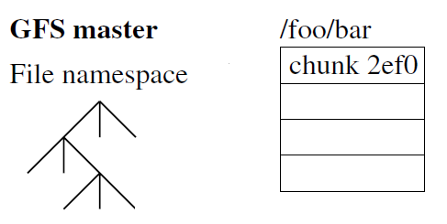
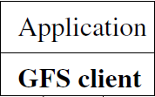
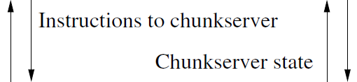

After Snapshot(Read/Write)
Reference: 1
Reference: 2
chunk 2ef1
Reference: 1
Write bar
Read bar
…
Chunk handle
Copy
Snapshot
Data
Chunk handle
….
: Chunk 2ef0
: Chunk 2ef1
Copy data
Copy data

Slide 60
Google File System
Motivations
Design Overview
System Interactions
Master Operations
Fault Tolerance

Slide 61
Master Operations
Namespace Management and Locking
Replica Placement
Creation, Rebalancing , Re-replication
Garbage Collection
Stale Replica Detection

Slide 62
Namespace Mgt and Locking
Allows multiple operations to be active and use locks over regions of the namespace
Logically represents namespace as a lookup table mapping full pathnames to metadata
Each node in the namespace tree has an associated read-write lock
Each master operation acquires a set of locks before it runs

Slide 63
Namespace Mgt and Locking (cont.)
If it involves:
Read locks on the
directory name
Either a read lock
or a write lock on
the full pathname
/d1/d2/…/dn/leaf
/d1
/d1/d2
…
/d1/d2/…/dn
/d1/d2/…/dn/leaf

Slide 64
Namespace Mgt and Locking (cont.)
How this locking mechanism can prevent a file /home/user/foo from being created while /home/user is being snapshotted to /save/user
 | Read locks | Write locks
Snapshot operation | /home | /home/user
 | /save | /save/user
Creation operation | /home | /home/user/foo
 | /home/user

Slide 65
Master Operations
Namespace Management and Locking
Replica Placement
Creation, Rebalancing , Re-replication
Garbage Collection
Stale Replica Detection

Slide 66
Replica Placement
Traffic between racks is slower than within the same rack
A replica is created for 3 reasons
  Chunk creation
  Chunk re-replication
  Chunk rebalancing
Master has a replica placement policy
  Maximize data reliability and availability
  Maximize network bandwidth utilization
  Must spread replica across racks

Slide 67
Chunk Creation & Rebalance
Where to put the initial replicas?
  Servers with below-average disk utilization
  But not too many recent creations on a server
  And must have servers across racks
Master rebalances replicas periodically
  Moves chunks for better disk space balance and load balance
  Fills up new chunkserver
Master prefers to move chunks out of crowded chunkserver

Slide 68
Chunk Re-replication
Master re-replicates a chunk as soon as the number of available replicas falls below a user-specified goal.
  Chunkserver dies, is removed, etc. Disk fails, is disabled, etc. Chunk is corrupt. Goal is increased.
Factors affecting which chunk is cloned first:
  How far is it from the goal
  Live files vs. deleted files
  Blocking client
Placement policy is similar to chunk creation
Master limits the number of cloning per chunkserver and cluster-wide to minimize the impact on client traffic
Chunkserver throttles cloning read

Slide 69
Master Operations
Namespace Management and Locking
Replica Placement
Creation, Rebalancing , Re-replication
Garbage Collection
Stale Replica Detection

Slide 70
Garbage Collection
Chunks of deleted files are not reclaimed immediately
Mechanism:
  Client issues a request to delete a file
  Master logs the operation immediately, renames the file to a hidden name with timestamp, and replies
  Master scans file namespace regularly
    Master removes metadata of hidden files older than 3 days
  Master scans chunk namespace regularly
    Master removes metadata of orphaned chunks
  Chunkserver sends master a list of chunk handles it has in regular HeartBeat message
    Master replies the chunks not in namespace
    Chunkserver is free to delete the chunks

Slide 71
Garbage Collection(cont.)
Delete /foo
Log
…
Metadata
…
…
Delete …
/.foo-20101013
/foo

Slide 72
Stale Replica Deletion
Stale replica is a replica that misses mutation(s) while the chunkserver is down
  Server reports its chunks to master after booting. Oops!
Solution: chunk version number
  Master and chunkservers keep chunk version numbers persistently.
  Master creates new chunk version number when granting a lease to primary, and notifies all replicas, then store the new version persistently
The master removes stale replicas in its regular garbage collection

Slide 73
Google File System
Motivations
Design Overview
System Interactions
Master Operations
Fault Tolerance

Slide 74
Fault Tolerance
High Availability
Data Integrity
Diagnostic Tools

Slide 75
Fast Recovery
Master and chunkserver can start and restore to previous state in seconds
  Metadata is stored in binary format, no parsing
  50MB – 100 MB of metadata per server
  Normal startup and startup after abnormal termination is the same
  Can kill the process anytime
    do not distinguish between normal and abnormal termination

Slide 76
Master Replication
Master's operation logs and checkpoints are replicated on multiple machines
  A mutation is complete only when all replicas are updated
If the master dies, cluster monitoring software starts another master with checkpoints and operation logs
  Clients see the new master as soon as the DNS alias is updated
Shadow masters provide read-only access
  Reads a replica operation log to update the metadata
  Typically behind by less than a second
  No interaction with the busy master except replica location updates (cloning)

Slide 77
Fault Tolerance
High Availability
Data Integrity
Diagnostic Tools

Slide 78
Data Integrity
A responsibility of chunkservers, not master
  Disks failure is norm, chunkserver must know
  GFS doesn't guarantee identical replica, independent verification is necessary
32 bit checksum for every 64 KB block of data
  available in memory, persistent with logging
  separate from user data
Read: verify checksum before returning data
  mismatch: return error to client, report to master
  client reads from another replica
  master clones a replica, tells chunkserver to delete the chunk

Slide 79
Diagnostic Tools
Logs on each server
  Significant events (server up, down)
  RPC requests/replies
Combining logs on all servers to reconstruct the full interaction history, to identify source of problems
Logs can be used on performance analysis and load testing, too

Slide 80
Summary of GFS
GFS demonstrates how to support large-scale processing workloads on commodity hardware
  designed to tolerate frequent component failures
  uniform logical namespace
  optimize for huge files that are mostly appended and read
  feel free to relax and extend FS interface as required
  relaxed consistency model
  go for simple solutions (e.g., single master, garbage collection)
GFS has met Google’s storage needs

Slide 81

How about Hadoop
HDFS

Slide 82
HDFS
Overview
Architecture
Implementation
Other Issue

Slide 83
What’s HDFS
Hadoop Distributed File System
  Reference from Google File System
  A scalable distributed file system for large data analysis
  Based on commodity hardware with high fault-tolerant
  The primary storage used by Hadoop applications
Cloud Applications
MapReduce
Hbase
Hadoop Distributed
File System (HDFS)
A Cluster of Machines

Slide 84
HDFS’s Feature(1/2)
Large data sets and files
  Support Petabytes size
Heterogeneous
  Could be deployed on different hardware
Streaming data access
  Batch processing rather than interactive user access
  High aggregate data bandwidth

Slide 85
HDFS’s Feature(2/2)
Fault-Tolerance
  The norm rather than exception
  Automatic recovery or report failure
Coherency Model
  Write-once-read-many
  This assumption simplifies coherency
Data Locality
  Move compute to data

Slide 86
HDFS
Overview
Architecture
Implementation
Other Issue

Slide 87
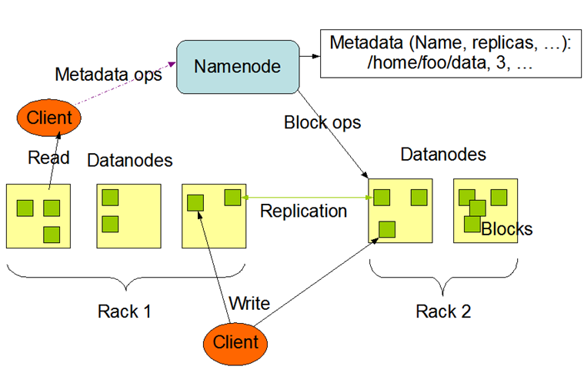
How to manage data
HDFS Architecture

Slide 88
Namenode
Each HDFS cluster has one Namenode
Manage the file system namespace
Regulate access to files by clients
Execute file system namespace operations
Determine the rack id each Datanode belongs to

Slide 89
Datanode
One per node in the cluster
Manage storage attached to the nodes that they run on
Serve read and write requests from the file system’s clients
Perform block creation, deletion, and replication

Slide 90
File System Namespace
Traditional hierarchical file organization
Does not support hard links or soft links
Change to the file system namespace or its properties is recorded by the Namenode

Slide 91
HDFS
Overview
Architecture
Implementation
Other Issue

Slide 92
Data Replication
Blocks of a file are replicated for fault tolerance
The block size and replication factor are configurable per file
Namenode makes all decisions regarding replication of blocks
  Heartbeat: Datanode is functioning properly
  Blockreport: a list of all blocks on a Datanode

Slide 93
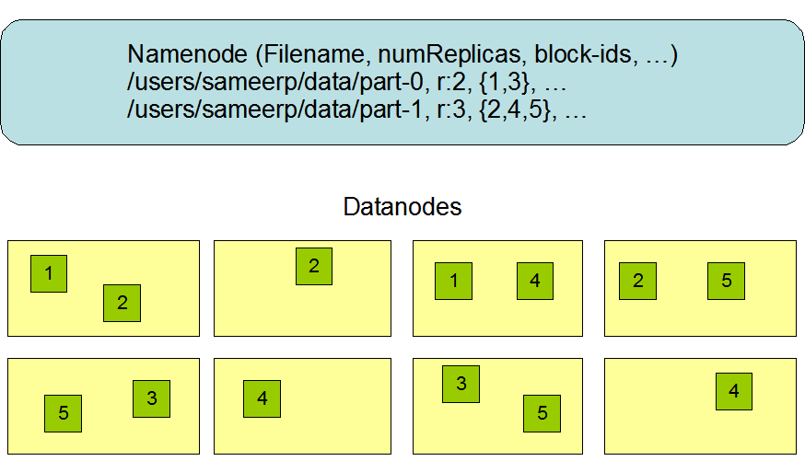
Block Replication

Slide 94
Replica Placement
Rack-aware replica placement policy
  data reliability
  availability
  network bandwidth utilization
To validate it on production systems
  learn more about its behavior
  build a foundation to test
  research more sophisticated policies

Slide 95
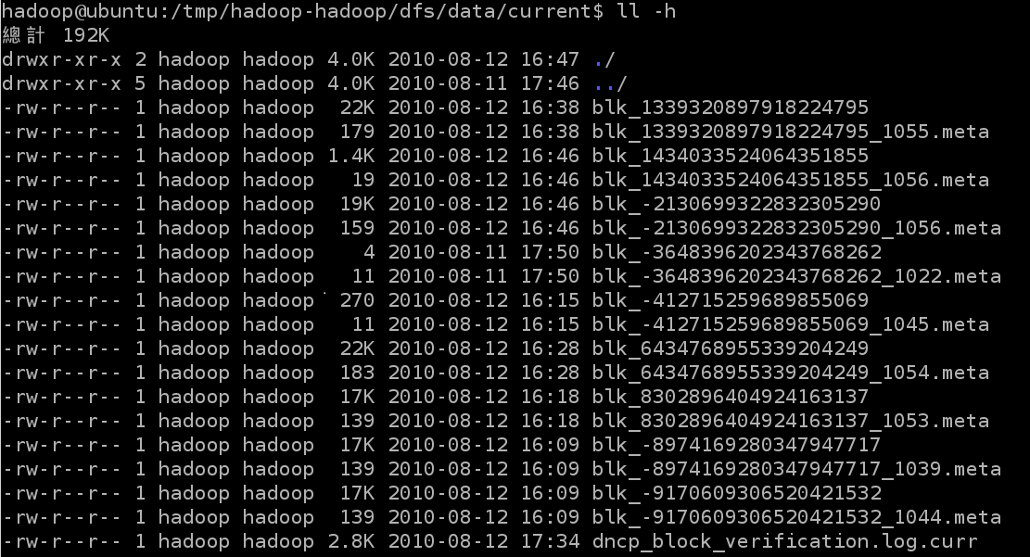
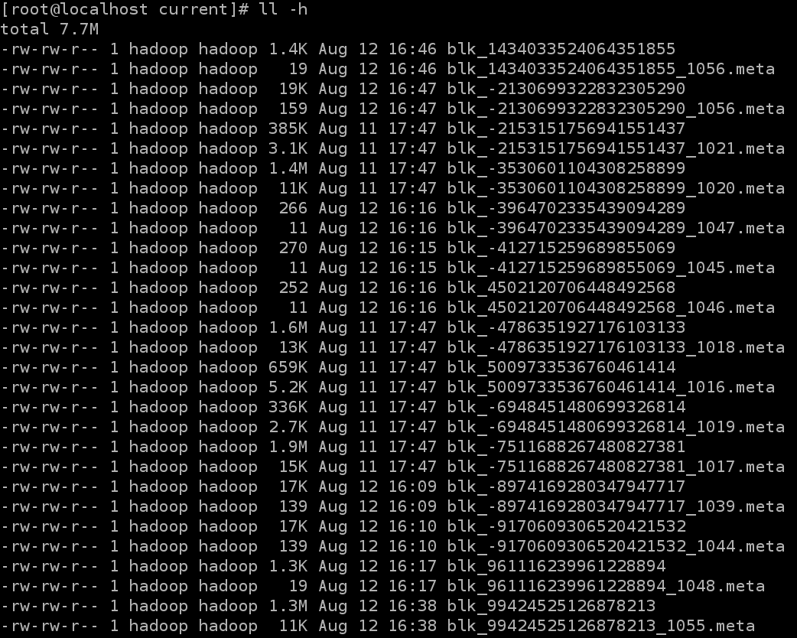
Screenshot
Number of Replicas:2

Slide 96
Why it Fault-Tolerance
Data Corrupt
  Checked with CRC32
  Replace corrupt block with replication one
Network Fault & Datanode Fault
  Datanode sends heartbeat to Namenode
Namenode Fault
  FSImage – core file system mapping image
  Editlog – like SQL transaction log
  Multiple backups of FSImage and Editlog
  Manually recovery while Namenode Fault
CRC: Cyclical Redundancy Check

Slide 97
Coherency Model & Performance
Coherency model of files
  Namenode handle the operation of write, read and delete.
Large Data Set and Performance
  The default block size is 64MB
  Bigger block size will enhance read performance
  Single file stored on HDFS might be larger than single physical disk of Datanode
  Fully distributed blocks increase throughput of reading

Slide 98
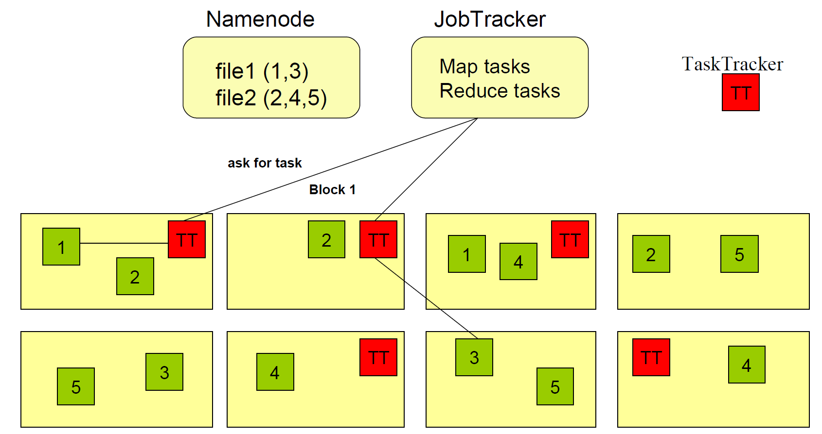
About Data locality

Slide 99
HDFS
Overview
Architecture
Implementation
Other Issue

Slide 100
Small file problem
Inefficiency of resource utilization
  Significantly smaller than the HDFS block size(64MB)
File, directory and block in HDFS is represented as an object in the namenode’s memory, each of which occupies 150 bytes
HDFS is not geared up to efficiently accessing small files
  Designed for streaming access of large files

Slide 101
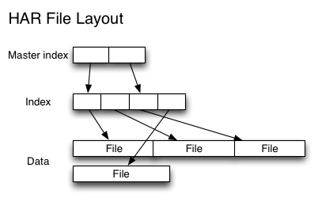
Small file solution
Hadoop Archives (HAR)
  Introduced to alleviate the problem of lots of files putting pressure on the namenode’s memory
  Building a layered filesystem on top of HDFS

Slide 102
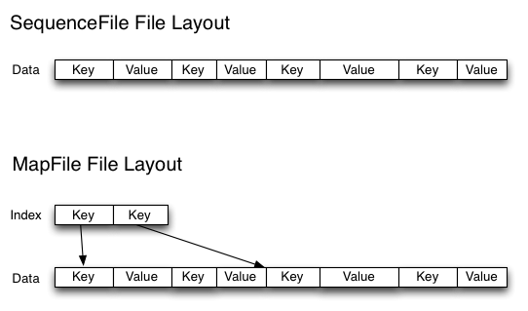
Small file solution
Sequence Files
  Use the filename as the key and the file contents as the value

Slide 103
Summary
Scalability
  Provide scale-out storage capability of handling very large amounts of data
Availability
  Provide the ability of failure tolerance such that data would not lose on machine or disk fail
Manageability
  Provide mechanism for the system to automatically monitor itself and manage the massive data transparently for users
Performance
  High sustained bandwidth is more important than low latency

Slide 104
References
S. GHEMAWAT, H. GOBIOFF, and S.-T. LEUNG, “The Google file system,” In Proc. of the 19th ACM SOSP (Dec. 2003)
Hadoop.
  http://hadoop.apache.org/
NCHC Cloud Computing Research Group.
  http://trac.nchc.org.tw/cloud
NTU course- Cloud Computing and Mobile Platforms.
  http://ntucsiecloud98.appspot.com/course_information

